Slide 1
Common Interaction Techniques

Slide 2
Explore
Notes:
There are numerous types of interactions a user could have with your visualization, you want to make sure these are communicated as intentionally as possible.

Slide 3
Taxonomy of Interactive Dynamics
Data and View Specification | Visualize data by choosing visual encodings. Filter out data to focus on relevant items. Sort items to expose patterns Derive values or models from source data.
[Heer & Shneiderman, 2012]
Notes:
Together, while not an all inclusive list, these provide some pretty good areas to think about when designing and building a visualization that best works with your data. Will talk through some common techniques and challenges to be aware of. Meant for designing visualization tools.

Slide 4
Taxonomy of Interactive Dynamics
View Manipulation | Select items to highlight, filter, or manipulate them. Navigate to examine high-level patterns and low-level detail. Coordinate views for linked, multi-dimensional exploration. Organize multiple windows and workspaces.
[Heer & Shneiderman, 2012]
Notes:
Together, while not an all inclusive list, these provide some pretty good areas to think about when designing and building a visualization that best works with your data. Will talk through some common techniques and challenges to be aware of.

Slide 5
Taxonomy of Interactive Dynamics
Process and Provenance | Record analysis histories for revisitation, review and sharing. Annotate patterns to document findings. Share views and annotations to enable collaboration. Guide users through analysis tasks or stories.
[Heer & Shneiderman, 2012]
Notes:
Together, while not an all inclusive list, these provide some pretty good areas to think about when designing and building a visualization that best works with your data. Will talk through some common techniques and challenges to be aware of.

Slide 6
Taxonomy of Interactive Dynamics
Data and View Specification | Visualize data by choosing visual encodings. Filter out data to focus on relevant items. Sort items to expose patterns Derive values or models from source data.
View Manipulation | Select items to highlight, filter, or manipulate them. Navigate to examine high-level patterns and low-level detail. Coordinate views for linked, multi-dimensional exploration. Organize multiple windows and workspaces.
Process and Provenance | Record analysis histories for revisitation, review and sharing. Annotate patterns to document findings. Share views and annotations to enable collaboration. Guide users through analysis tasks or stories.
[Heer & Shneiderman, 2012]
Notes:
Together, while not an all inclusive list, these provide some pretty good areas to think about when designing and building a visualization that best works with your data. Will talk through some common techniques and challenges to be aware of.

Slide 7
Fundamental Interactions
Notes:
We talk about navigation in a different segment.

Slide 8
Filter
Filter to focus on certain data
(e.g., time segment, categories)

Slide 9
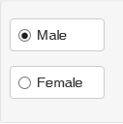
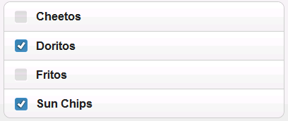
Filter
When a small number of items:
Radio buttons
Check boxes

Slide 10
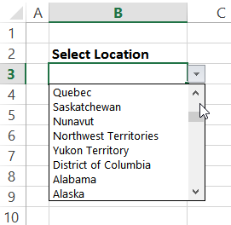
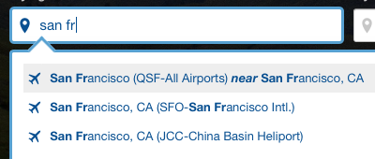
Filter
When a large number of items:
Scroll
Hierarchy
Search with autocomplete

Slide 11
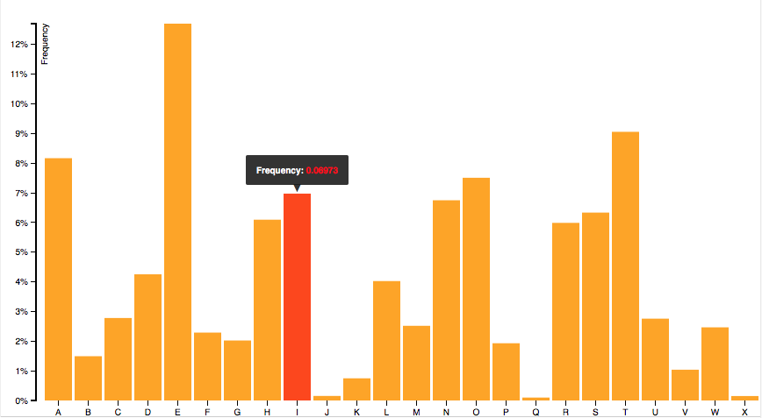
Selection
Mouseover/ hover
Sticky mouseover
Tap/click
Drag
Keyboard (tab, keyboard cursor)
Justin Palmer
Notes:
Selection = mark something as interesting
Mouseover – temporary
Sticky mouseover – some charts do this, Highcharts
Tap/click – direct selection (can include key for multiple)
Drag – multiple selection( bounding box, lasso)
Keyboard – tab, Jaws cursor

Slide 12
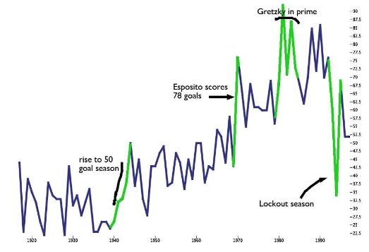
Perceptual Annotation
[Kong & Agrawala, 2009]
Notes:
Not just getting information but also leaving information with selection, also provide information, while not as common, can be a powerful technique visualization to allow other users to interact and annotate areas of interest. http://vis.berkeley.edu/papers/annotationInterpretation/AnnotationInterpretation-UIST09.pdf
Figure Shows.
Annual number of goals scored by leading scorer
in the National Hockey League from 1917 to 1997

Slide 13
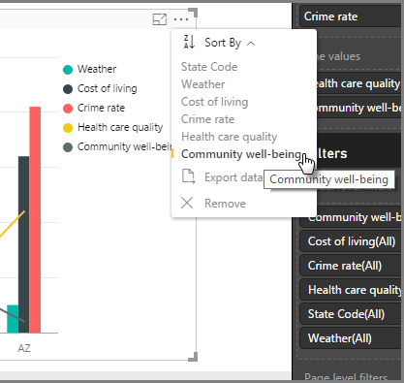
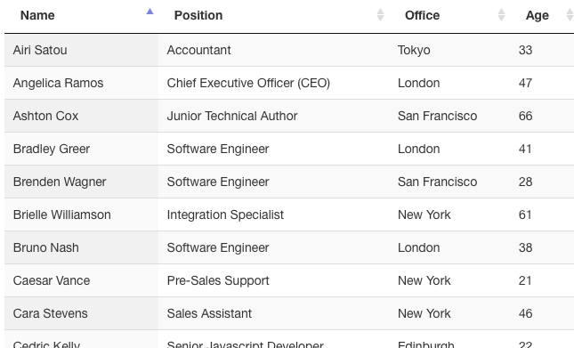
Sort
Drag
Keyboard (e.g., arrow keys)
Sort by selection
DataTables, Microsoft
Notes:
Sorting by dragging or using a keyboard is pretty tedious
More common: sort tables by clicking headers, select a sort from a menu

Slide 14
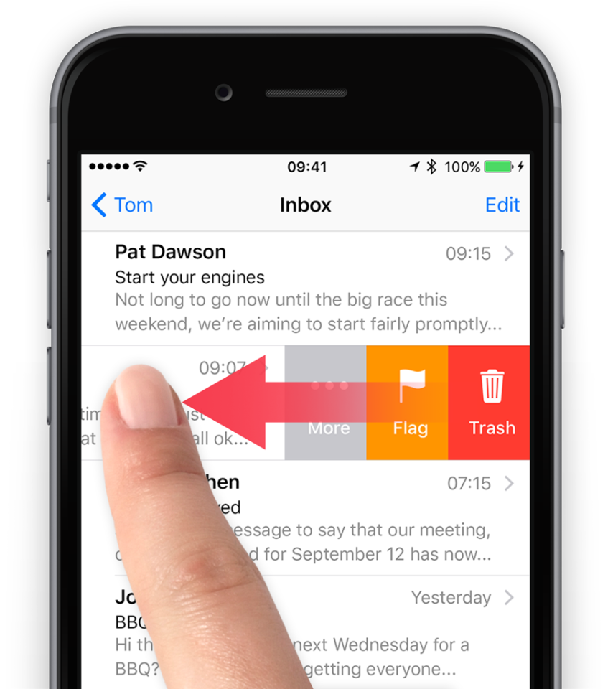
Deletion
Select and apply
Select and use keyboard (e.g., delete key)
Drag out
Swipe right or left
Tapsmart
Notes:
Not mentioned in the taxonomy.

Slide 15


